Slide 1
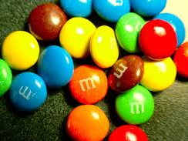
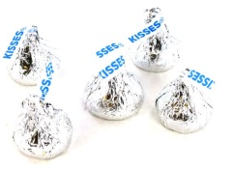
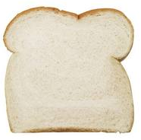
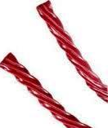
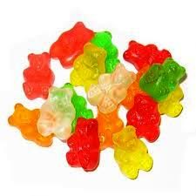
A Lesson in Candy Relativity
26
5
Milk Chocolate M & Ms
Hershey’s Kisses
25
4
Tic Tacs
=
Gum Drops
20
3.5
Raisinettes
Starburst
14
2
Jelly Bellys
Twizzlers
8
1
Haribo Gummy Bears
Tootsie Pop
A serving of candy may be bigger or smaller than you think. See how many pieces of these favorites equal one serving of carbohydrate as measured by one slice of white bread.
www.ffactor.com

